Slide 1
Identifying High-Spending E-commerce Customers
Wang Wei Yu

Slide 2
Table of contents
01
02
03
04
Problem Framing & Data Info
Tableau Dashboard Insights
Predictive Modelling & Streamlit Demo
Recommendations & Next Steps

Slide 3
How can we identify high-spending customers based on their behavioural and demographic traits to improve targeting and optimise marketing spend?

Slide 4
Data Info
Data source: Kaggle
https://www.kaggle.com/datasets/salahuddinahmedshuvo/ecommerce-consumer-behavior-analysis-data
Synthetic data: 28 columns x 1001 rows [2024]
Age, Gender, Marital Status, Income Level, Education Level, Occupation, Location, Customer Loyalty Program Member
Purchase Intent, Discount Sensitivity, Discount Used, Time to Decision, Engagement with Ads, Social Media Influence, Product Rating, Device Used for Shopping, Shipping Preference, Return Rate
Features Created:
Spend Score = Purchase Amount x Frequency of Purchase
Spend Binary: High spending customer has a spend score of more than 3000 (~ Top 20%)
Limitations:
Missing data granularity: Education, income and occupation only labelled as “medium” or “high”
Return Rate had only 3 values (0–2): Assumed that 0 meant no returns, 1 meant low returns and 2 meant high returns

Slide 5
Personas
Clara Tan
Darren Lee
Aisha Rahman
CRM & Loyalty Manager
Senior Digital Marketing Analyst
UX Researcher, Product
Responsibilities:
Oversees segmentation and retention strategies
Designs loyalty programmes and exclusive campaigns
Pain Points:
Current loyalty programme members don’t always match the highest spenders
Lacks clarity on which demographic or shopping patterns indicate long-term loyalty versus one-off big spenders
Responsibilities:
Manages digital ad campaigns and paid targeting strategies
Tracks conversion metrics and optimises ad spend
Pain Points:
Marketing budgets are wasted on low-intent users
Struggles to distinguish between browsers and serious buyers based on engagement metrics alone
Responsibilities:
Conducts behavioural research to improve user journeys
Identifies friction points in the online shopping process
Pain Points:
Can’t tell which parts of the shopping experience matter most to top spenders
Lacks prioritisation framework for high-impact UX features changes

Slide 6
Goals
Uncover key traits of high spenders to support targeted marketing strategies, personalised promotions and guide loyalty program enhancements
Build a predictive model that can accurately classify customers as high or low spenders
Success Criteria
A classification model with ≥ 75% for:
Accuracy: % of total correct predictions
Precision: % of actual positives out of the predicted positives (TP/TP + FP)
Recall: % of actual positives caught by model (TP/TP + FN)

Slide 7
Approach to Predicting High-Value Customers
Clean Data
Features Creation
Exploratory Data Analysis
Selecting Top 10 Features
Transforming Data
Test Different Models
Evaluation
Streamlit Web App

Slide 8
Selecting Top 10 Features: Correlation Analysis for Numerical Features
Which customer traits tend to move together with spending? (larger number > stronger relationship)
Time to Decision (Days) | 0.048
Discount Used (True/False) | 0.015
Product Rating (1 to 5) | -0.283
Return Rate (0 to 2) | -0.284
Age | -0.034
Brand Loyalty (1 to 5) | -0.051
Customer Loyalty Program Member (True/False) | -0.084

Slide 9
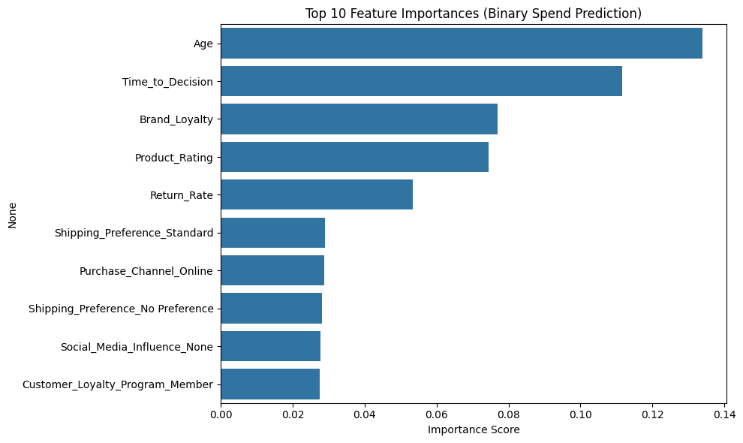
Selecting Top 10 Features: Feature Importances
One-Hot Encoding:
Turn categories into columns of 1s and 0s
Standard Scaler:
Transforms numbers so they follow a similar scale from -1 to 1 (more needed for KNN)
Create binary model
Features Importance:
How much each feature contributes to making accurate predictions
Model tests different combinations of features and tracks which ones reduce uncertainty the most

Slide 10
Transforming Data with SMOTE
More low spenders > difficult for model to learn what a high spender looks like
SMOTE (Synthetic Minority Over-sampling Technique) blends features of nearby high spender records to generate new examples
This balances the classes and lets the model get better practice by identifying high spenders
Used for Random Forest and XGBoost models

Slide 11
Model Evaluation
Model Type | Hyperparameters (Grid Search CV) | Accuracy | Precision | Recall
Random Forest Many independent decision trees vote Majority vote decides final class | Default N estimators: 100 Max depth: none (unlimited) Min samples split: 2 | 81% | 83% | 77%
XGBoost Builds trees consecutively to correct past mistakes Combines to predict | N estimators: 200 Max depth: 6 (questions a tree can ask) Learning rate: 0.1 | 79% | 78% | 81%
K-Nearest Neighbour If more neighbours are high spenders, predicted to be high spender | N neighbours: 11 Weights: Distance (closer counts more) Metric: Manhattan (absolute distance) | 73% | 76% | 68%

Slide 12
Recommendations
Expand Loyalty Programme
Increase Social Media Influence & Presence
Increase members, particularly from age 24 to 36
Promote programme with additional discounts
Non-members spend more with higher social media influence
Create more compelling social media advertisements as high spenders typically engage well with ads
Improve Online Platform
Send Targeted Messages
Make browsing and checkout experience more seamless on website
Create loyalty app, integrate in-store experience
Send reminders with promotions based on their membership tier through email or app after 7 days

Slide 13
Next Steps
Income tiers, marketing channels & costs
1
Collect more detailed info
2
Integrate location data
Geographical trends
3
Random forest model
Less training time & memory usage
4
Regression models
Predict spend score

Slide 14
Thank You

